Slide 1
ISO 27001 Risk Assessment Project

Slide 2
Project Overview
This project focuses on identifying, analyzing, and managing cybersecurity risks in an organization using industry-standard frameworks like ISO 27001

Slide 3
Risk Identification Process
Assets Identification → Threat Identification → Vulnerability Analysis → Risk Calculation → Risk Treatment

Slide 4
Risk Matrix
Impact ↓ / Likelihood →
Low Impact + Low Likelihood = Low Risk
High Impact + Low Likelihood = Medium Risk
Low Impact + High Likelihood = Medium Risk
High Impact + High Likelihood = High Risk

Slide 5
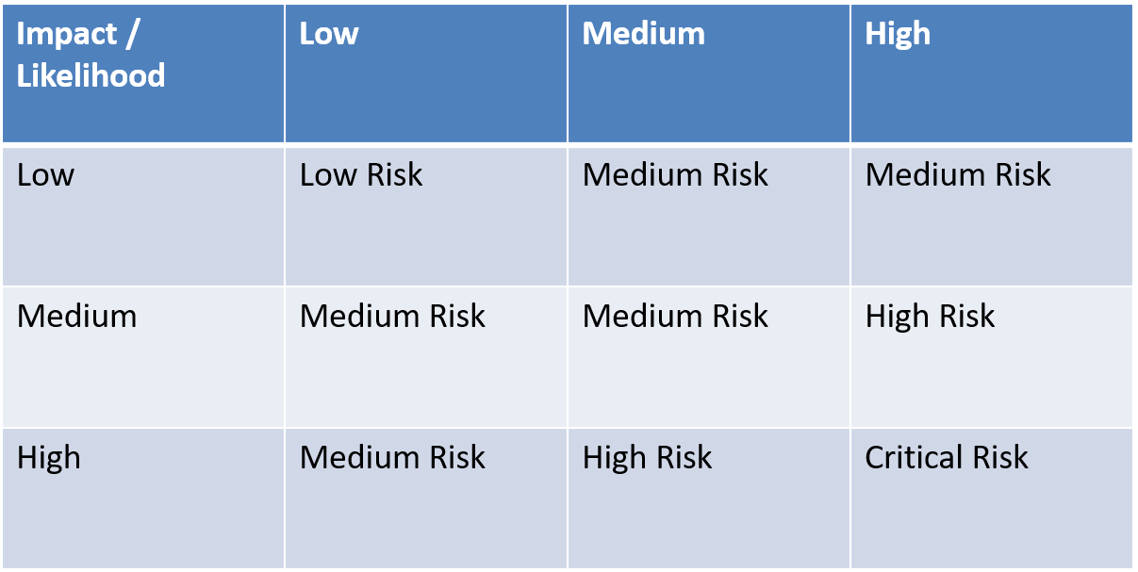
Risk Matrix Table

Slide 6
Risk Treatment Strategies
Risk Avoidance → Remove the risk
Risk Mitigation → Reduce impact/likelihood
Risk Transfer → Insurance / Third-party
Risk Acceptance → Accept and monitor

Slide 7
Conclusion
This project demonstrates a cybersecurity risk assessment approach

